Slide 1
Each person is loved by God !

Slide 2
The origins

Slide 3
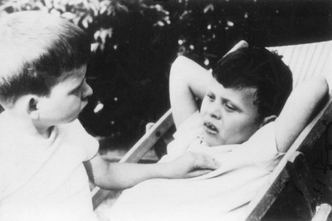
1968 To answer the call of the parents of Thaddée and Loïc, two children with intellectual disabilities, Marie Hélène Mathieu and Jean Vanier organised with them a pilgrimage to Lourdes...
Notes:
Everything started in 1968 through the suffering of Gerard and Camille, the parents of Thaddée and Loïc, who had a deep intellectual disability. When they travelled together for a pilgrimage in Lourdes, they felt marginalised, almost excluded.
With them, Jean Vanier and Marie-Hélène Mathieu suggested a pilgrimage dedicated to the children, teenagers and adults with an intellectual disability, along with their parents and friends, particularly young people. It would be called « Faith and Light », and be prepared in small communities.

Slide 4
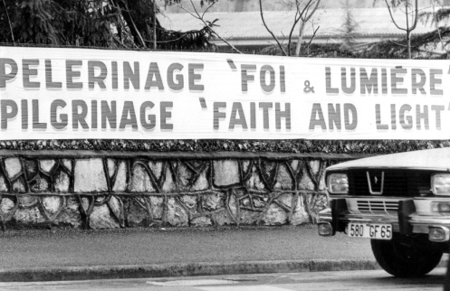
1971 : First international pilgrimage
Birth of Faith and Light
Notes:
For Easter 1971, 12.000 pilgrims from 15 countries met in Lourdes. 4000 of them are people with an intellectual disability. Three days of pure joy and peace. All discover that a person with an intellectual disability is not disabled in his heart and only wish to love and to be loved. Seeking unity, they do away with racial and language barriers, age and social stereotypes, and call us to ecumenism, despite our different christian traditions.

Slide 5
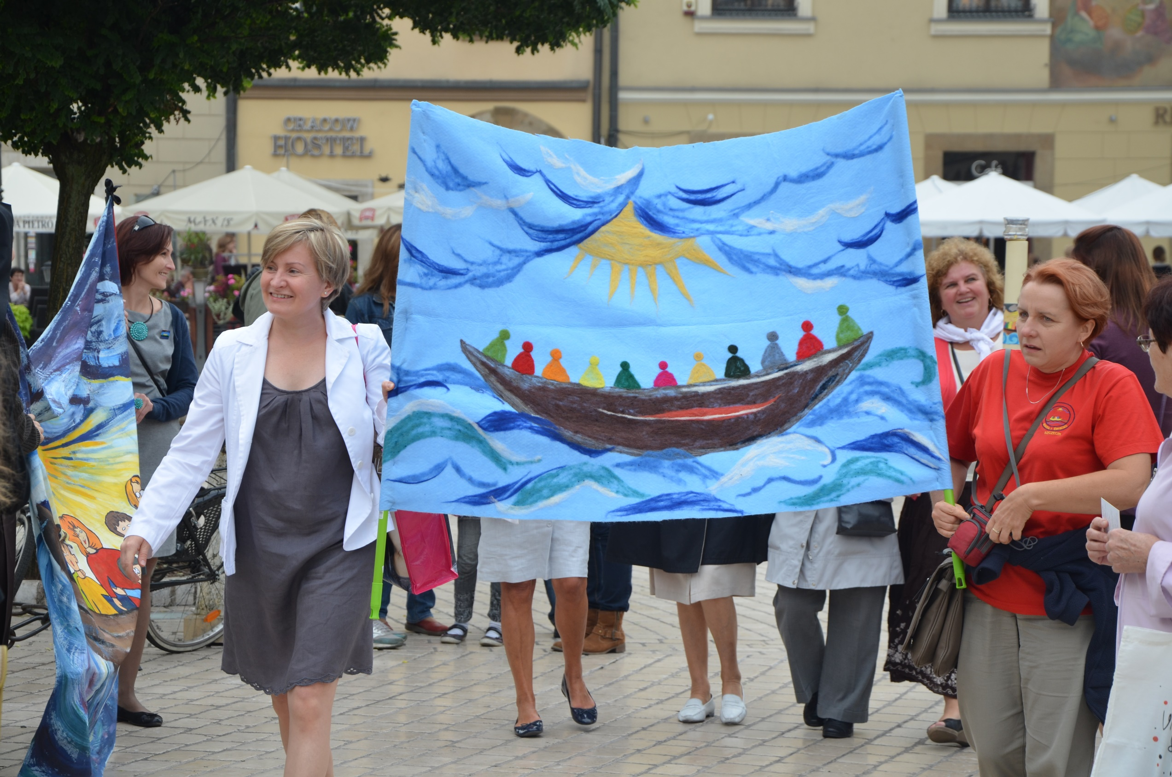
« Do all that the Holy Spirit inspires you to do»
Notes:
On the last day, pilgrims can not accept that it is over. Jean Vanier then suggests: “Continue to meet in small communities and do all that the Holy Spirit inspires you do to”. And so was born the international mouvement of Faith and Light on that Easter Monday in Lourdes.

Slide 6
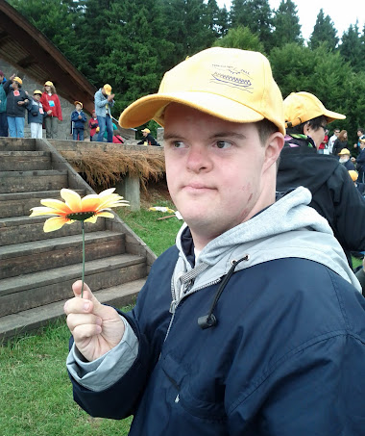
“You are loved by God as you are”
Notes:
In 1975, another international pilgrimage to Rome. Paul VI welcomes 5000 Faith and Light pilgrims. Speaking to every person with an intellectual disability, he says : « You are loved by God, as you are » and confirms Faith and Light’s mission in the Church. Other international pilgrimages will follow in 1981, 1991 and 2001.

Slide 7
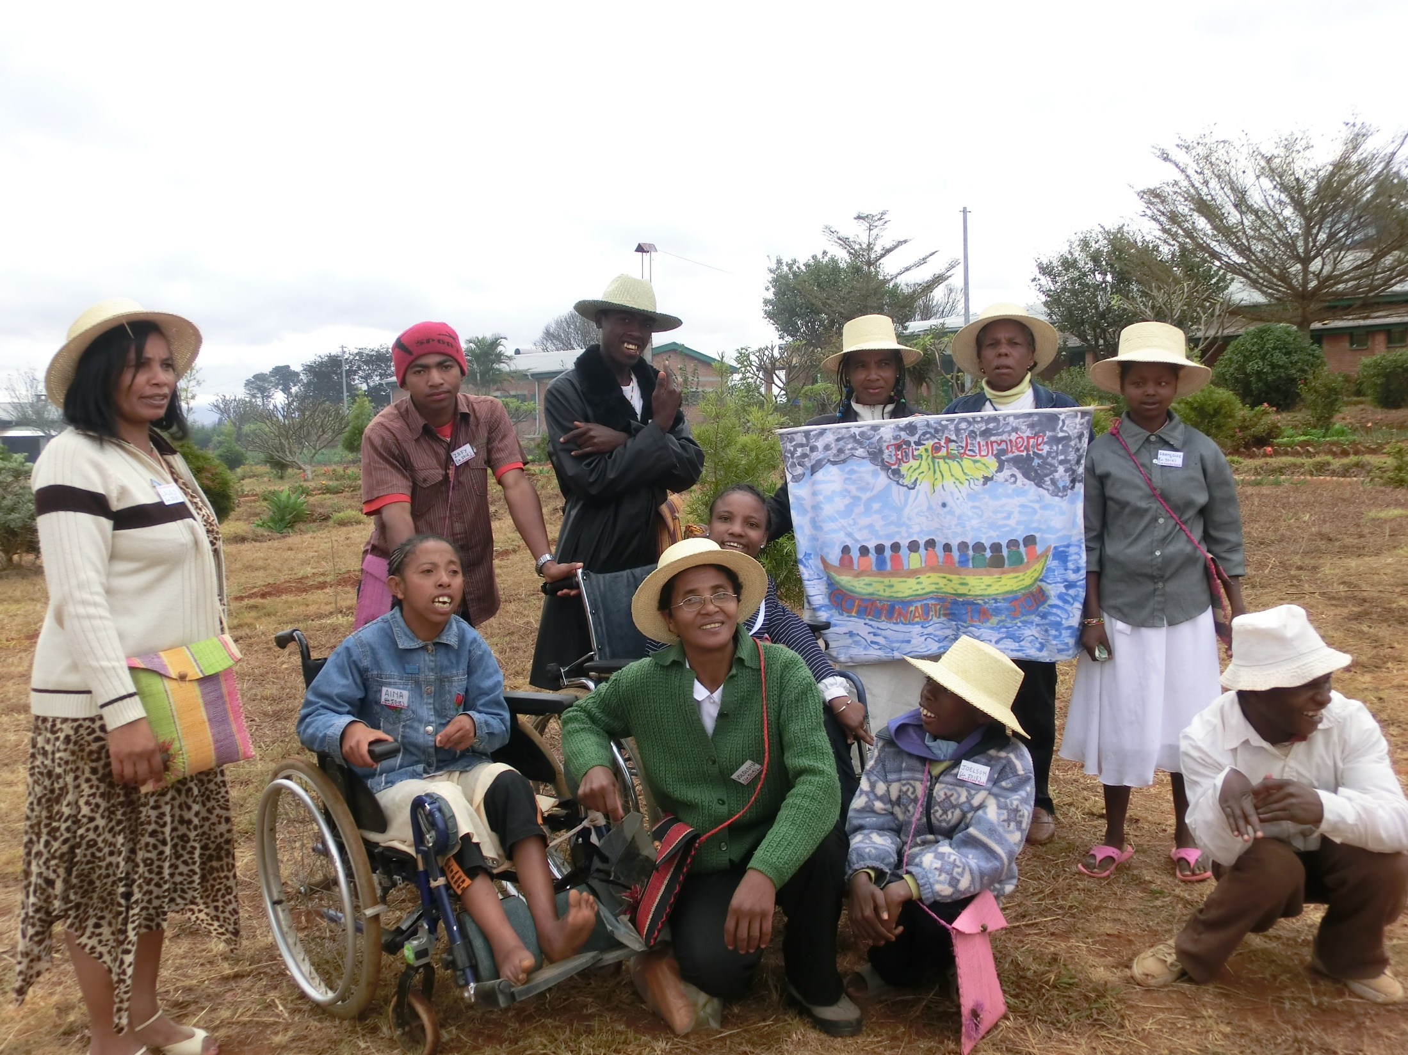
Many Faith and Light communities are born around the world
Notes:
Today, about 1350 commununities exist in 86 countries on the five continents and gather regularly for a time of friendship, of sharing, of prayer and of celebration.

Slide 8
The community
is composed of…

Slide 9
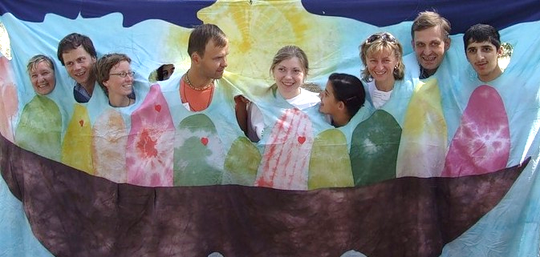
Persons with an intellectual disability
Their family
Friends
A chaplain
Notes:
Faith and Light is a community mouvement. At the heart of every community are persons with a more or less serious intellectual disability: children, adolescents or adults. They are surrounded by members of their family and friends, particularly young people. Each community is asked to be accompanied by a chaplain.

Slide 10
Faith and Light A treasure to share…

Slide 11
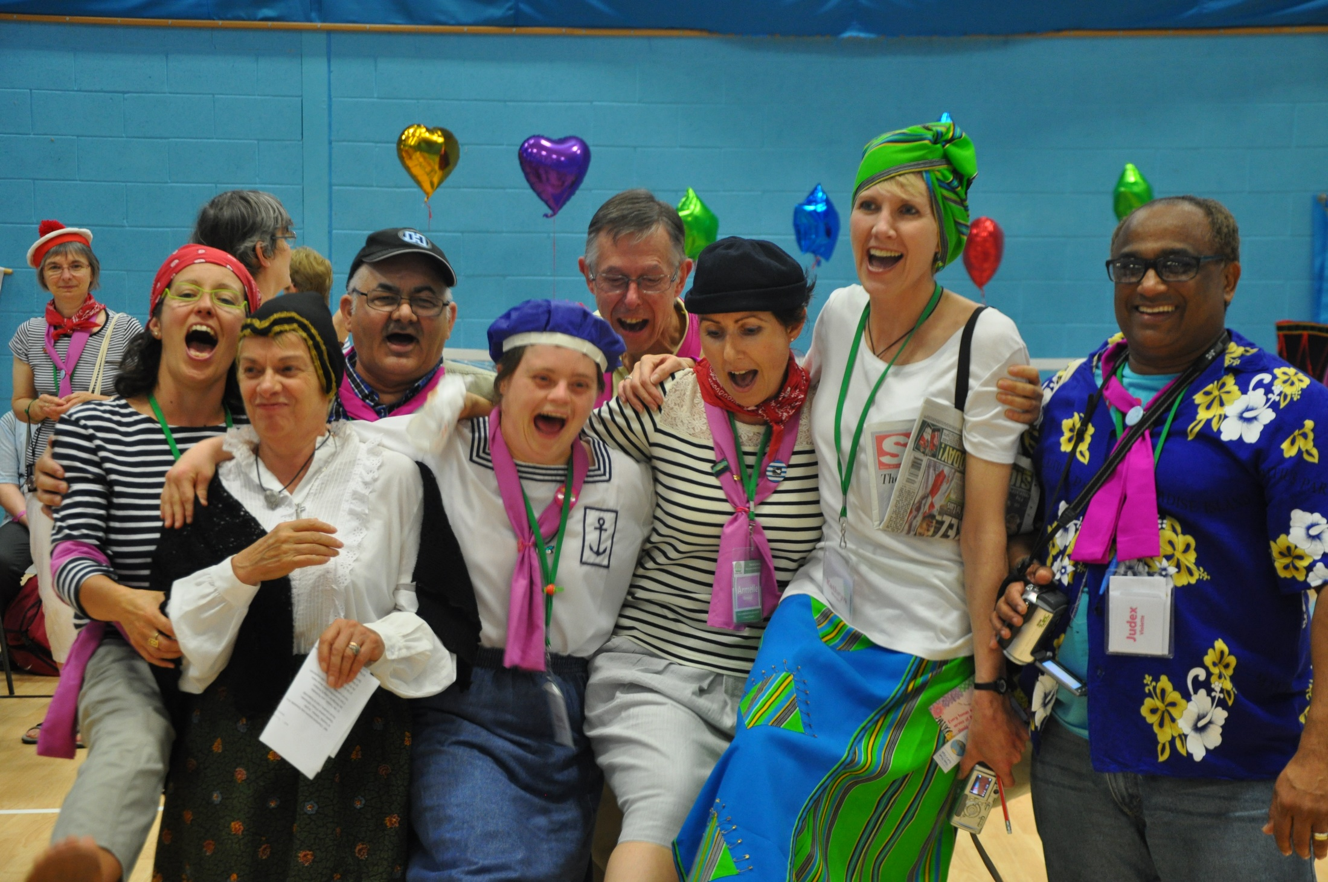
To the person with disabilities
Faith and Light brings
Recognition
The joy of friendship
Opportunity to exercise one’s talents
Notes:
Faith and Light gives to persons with an intellectual disability the possibility of being recognized as unique persons, of using their gifts and discovering the joy of friendship.

Slide 12
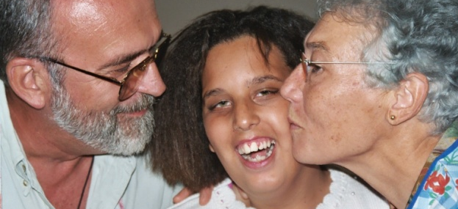
To the parents and family
Support in their hardship
Inner beauty of their child
being in contact with other parents
Notes:
To the parents, Faith and Light gives support in their trials and helps them to better appreciate the inner beauty of their children. A number of them, in turn, become a source of strength and an assistance to other parents who are crushed by their suffering and their daily difficulties.
The brothers and sisters of the people with an intellectual disability are called to appreciate that a person with a disability can be a source of life and unity; if this person disrupts their life, he/she can also transform and transfigure it. (Charter I)

Slide 13
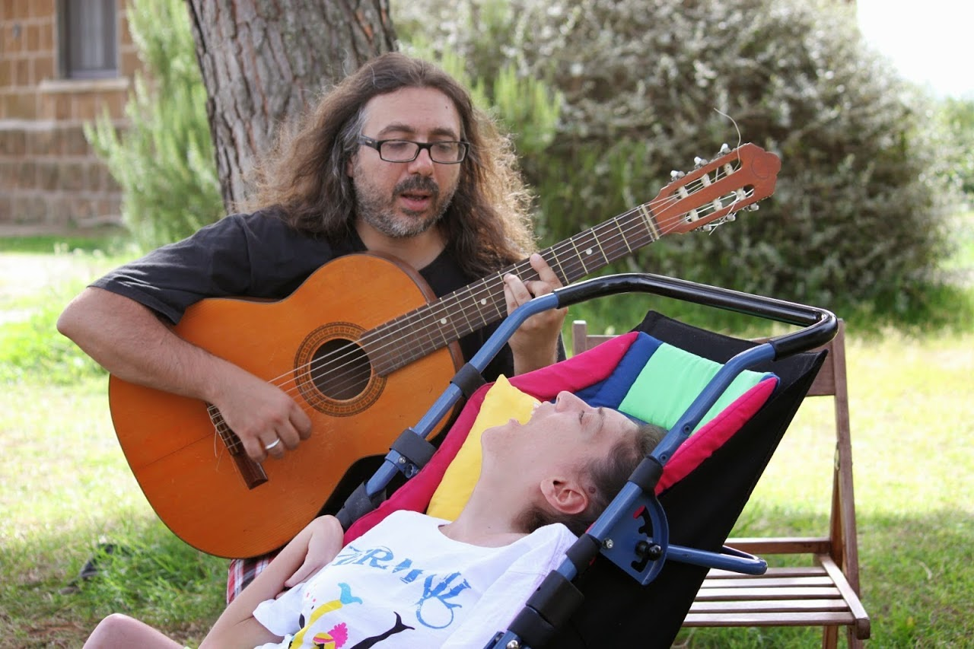
To the friends
Faithfulness and attention
Faith
New meaning to their life
Notes:
Thanks to the person with an intellectual disability, the friends also come to understand that there is another world, a world other than that of competition, money and success; those who are weak and poor invite them into a world of tenderness and fidelity, of listening and of faith.
(Charter I)

Slide 14
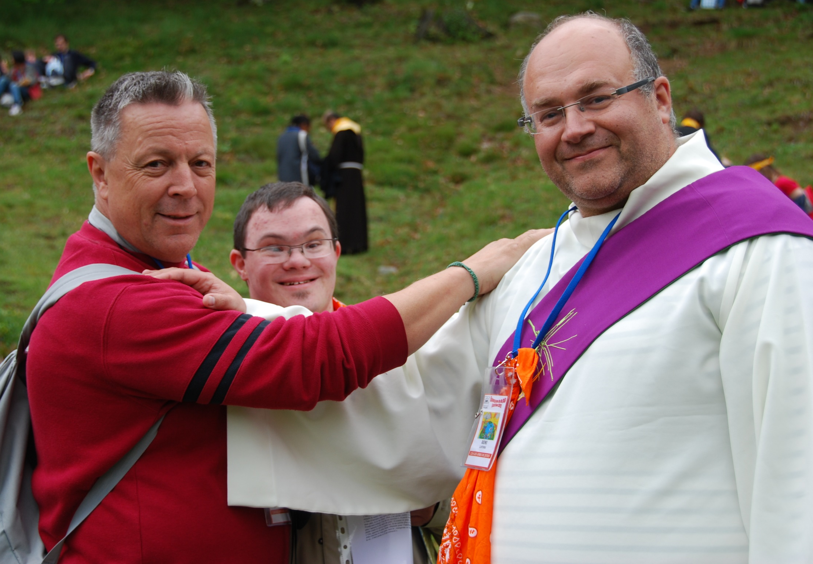
To the chaplains
Witness the Beatitudes
and live the Gospel of smallness
Notes:
To the chaplains, Faith and Light offers the opportunity to rediscover in a new way the core of the Gospel message, the good news of Jesus Christ, announced to the poor and little ones, and to find there a source of renewal for their ministry. (Charter I)

Slide 15
The life of the community

Slide 16
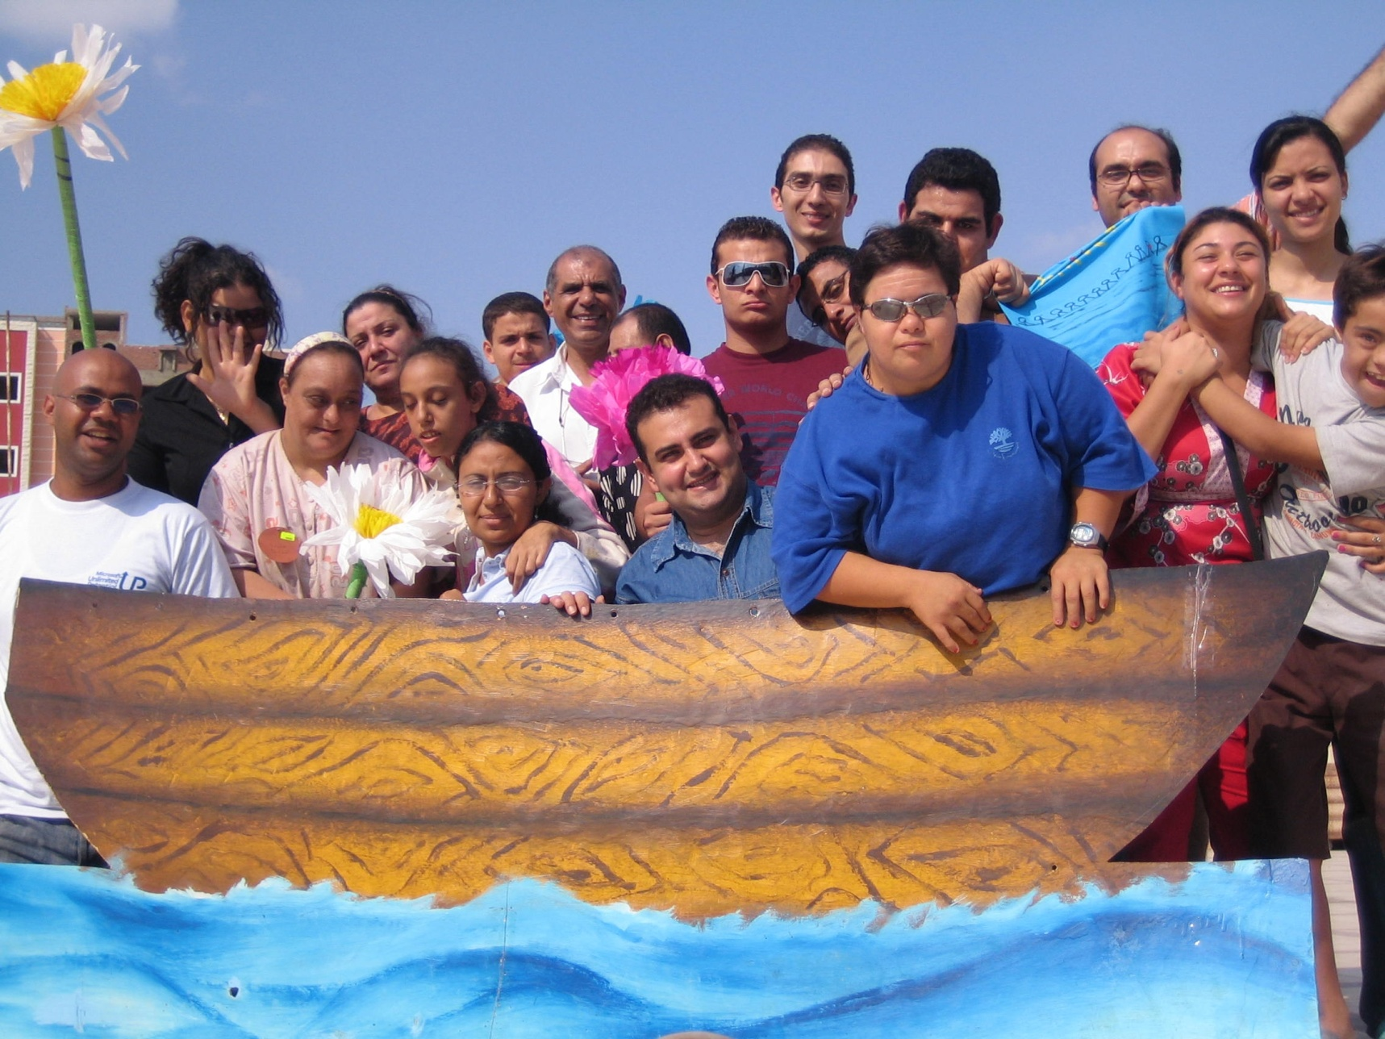
A community that meets
Notes:
Each meeting includes a time of getting together to talk and to listen to one another. The essential thing is to form personal relationships within which we discover the suffering and the gifts of one another, where we learn to know someone else by name. Sharing in small groups enables each person to express him/herself through words or other forms of communication, e.g. drawings, modelling, mimes or gestures. In this way we seek to “be with”, carrying one another's burdens, to encourage and support each other and to respond to the needs of each one. Through friendship, made up of tenderness and fidelity, we become signs of the love of God for one another.
(Charter 1, 1)

Slide 17
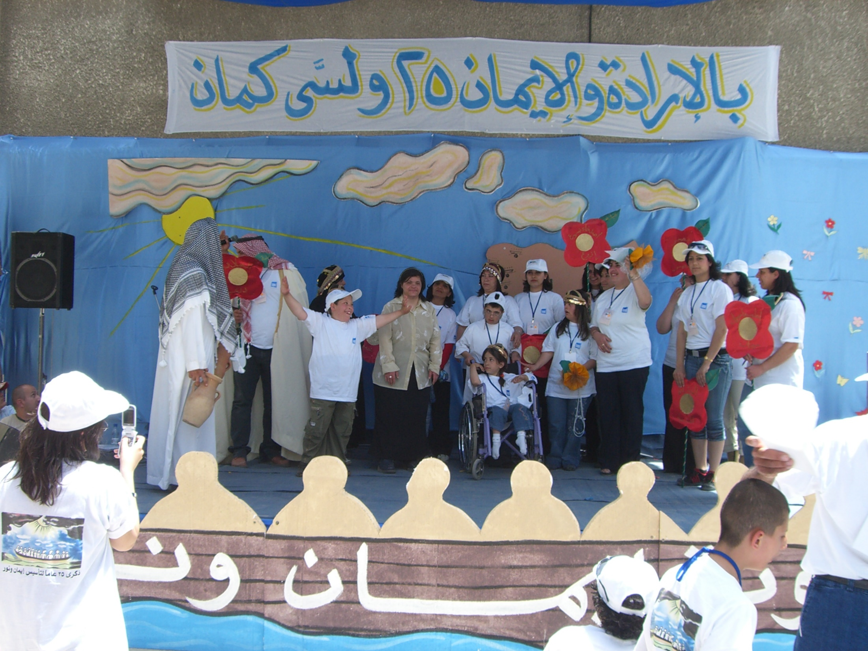
A community of Fiesta and Celebration
Notes:
From faithful friendship springs the joy characteristic of the Faith and Light community. It is God who calls us together and enables us to discover the covenant that unites us: we are no longer alone. Meetings are characterized by moments of joy when we sing or dance or share a meal. From time to time a day of celebration enables us to invite guests who are moved by the discovery of the capacity of someone with an intellectual disability to create this joyful atmosphere. When it comes to celebration the person with an intellectual disability is often less disabled than others, because he/she is not imprisoned by convention, worry about efficiency or fear of what others may think. People with disabilities live more simply in the present moment; their humility and transparency make them naturally disposed towards community festivity. (Charter 1, 2)

Slide 18
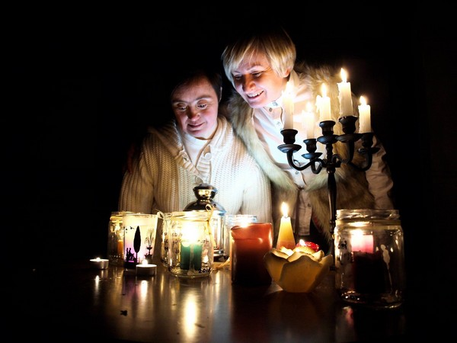
A community of prayer
Notes:
Jesus came to announce the Good News to the poor. They are loved by the Father. Jesus gave His life for his flock. He feeds them with his Body. Jesus is present in our gathering and in our celebration. He helps us to live community life with love and fidelity. We meet him in a special way in prayer, in the celebration of the Eucharist and/or in other forms of worship. (Charter 1, 3)

Slide 19
A community of friendship and faithfulness
Notes:
Friendship deepens through time and presence. Between the monthly gatherings the members of the community choose to spend time together in smaller groups or just meeting one-to-one. They share stories, fears, dreams, hope, prayer, fun, service with others, a meal, and other activities which nurture friendship: it is “the time of fidelity”, also called the “fourth time”.
(Charter 1, 4)

Slide 20
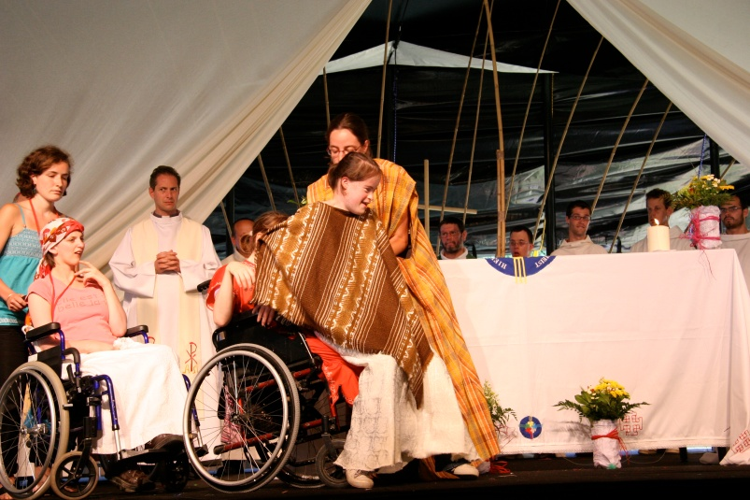
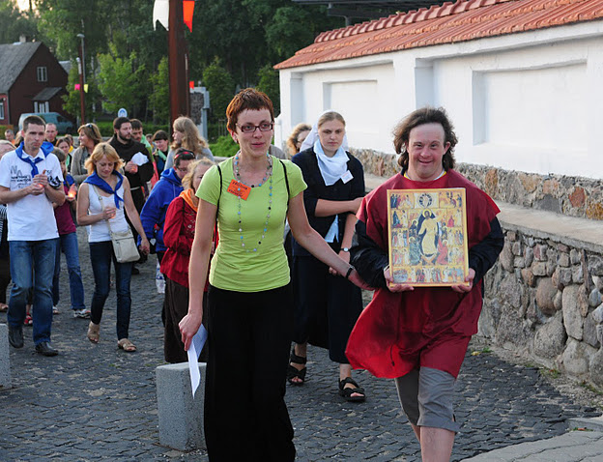
A community for taking root and integrating
Notes:
Faith and Light takes great care in integrating its communities and their members in the activities of the wider Faith and Light family, society, their respective Churches, Christian communities, parishes, etc.
This vocation for taking root, which lies with every person and every community, leads us to discover also our ecumenical vocation and mission (…)
Faith and Light believes that the person who is weak and disabled can become a source of unity in society and in each Church and also between Churches and nations. (Charter 1, 5)

Slide 21
The inspiration of Faith and Light

Slide 22
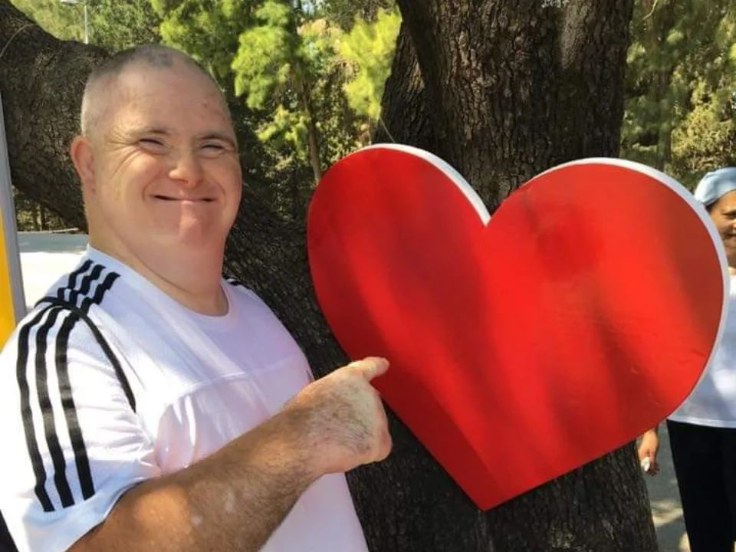
Each person is loved by God
Notes:
Faith and Light is founded on the belief that each person with an intellectual disability is fully a person with all the rights of a human being: above all the right to be loved, recognized and respected for himself or herself and in the choices he/she makes; the right also to receive whatever help is necessary in order to grow at every level, spiritual and human. Faith and Light also believes that every person, able-bodied or disabled, is equally loved by God and that Jesus lives in them, even if the person concerned can barely express this. Faith and Light believes that every person, even the most disabled, is called to deepen his or her life in Jesus. (Charter II, 1)
In order to live his/her faith, everyone, even the person with the most severe disability, needs to meet real friends in order to create together a warm environment in which each one may grow in faith and love. Those who come to Faith and Light to meet people with intellectual disabilities must come in a spirit of receiving from them their specific gifts while sharing their own gifts with them. (Charter II, 2)
In order to help people with intellectual disabilities to find peace of heart, hope and the desire to grow, it is certainly necessary to see them in the light of the Gospel, but also to understand their human needs in their suffering, and to know how to respond. For this, we must gradually acquire human experience and the necessary knowledge.

Slide 23
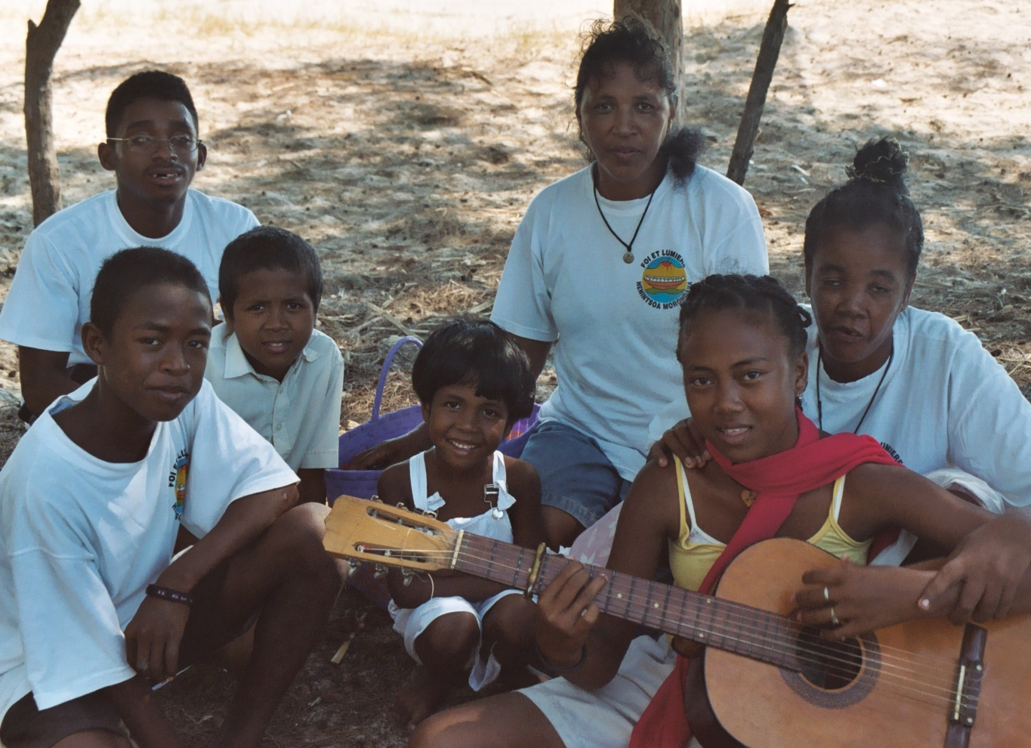
The need for a community

Slide 24
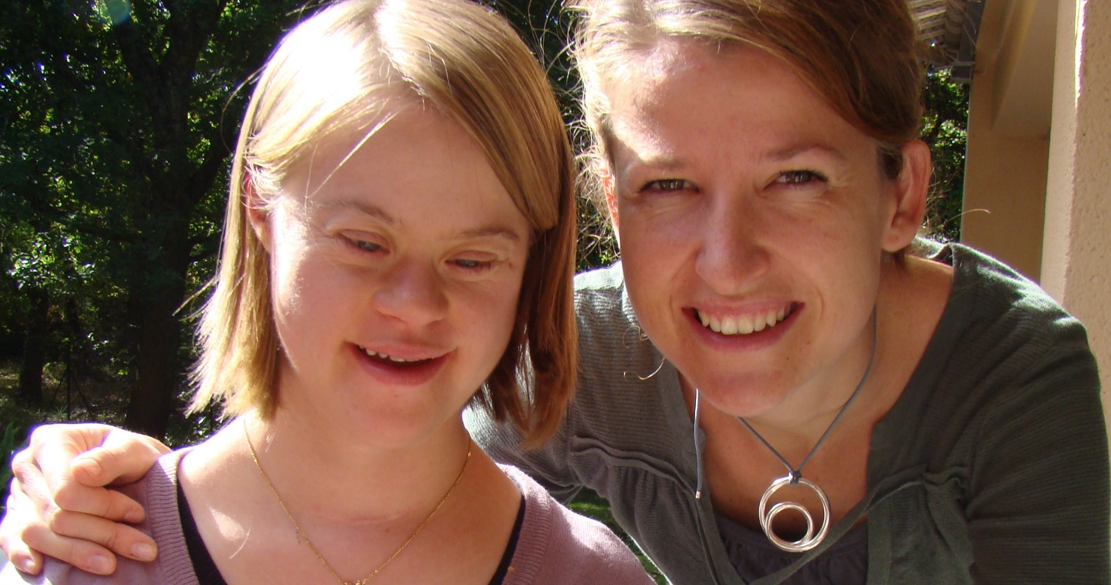
Accompaniment toward a deeper human maturity

Slide 25
The Faith and Light activities

Slide 26
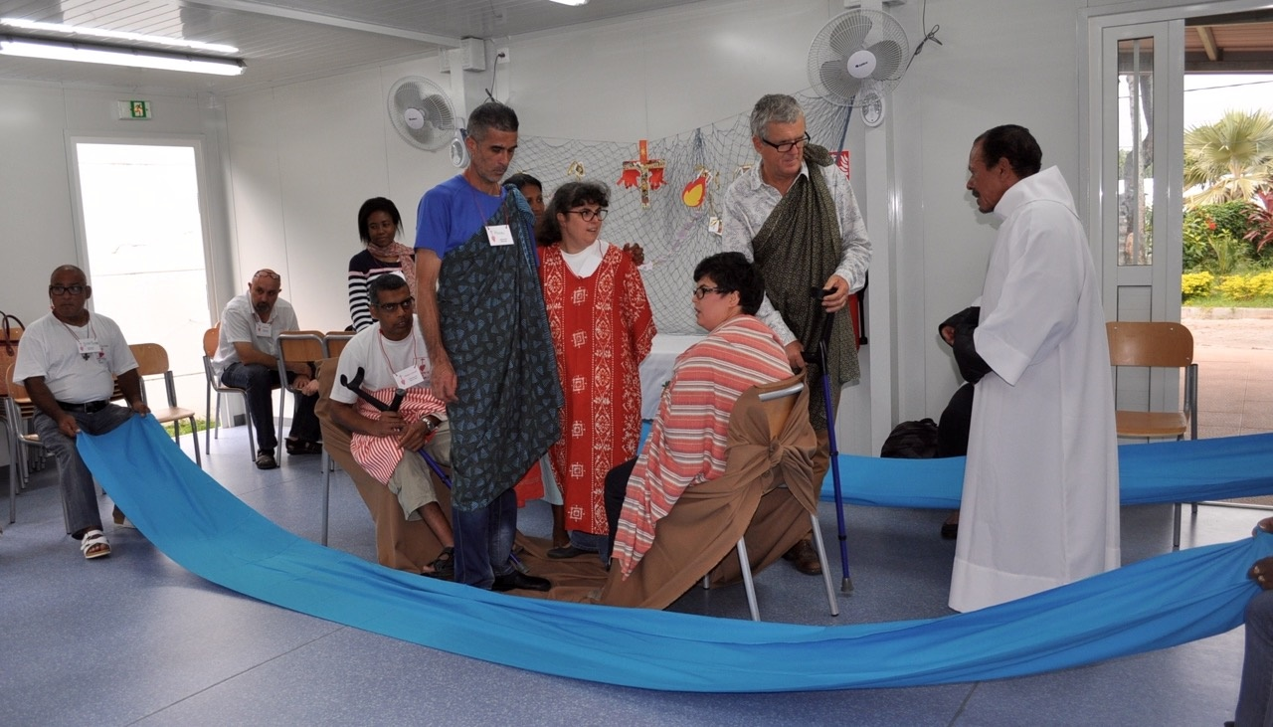
Meetings
Notes:
The communities may have many activities other than the regular meetings. They arise according to the needs and creativity of individuals and the inspiration from God. Among these initiatives are holiday camps, retreats and pilgrimages, etc.
On the other hand, certain communities organize means of welcoming and animating activities for people with intellectual disabilities to enable their parents to have a rest. (Charter III, 2)

Slide 27
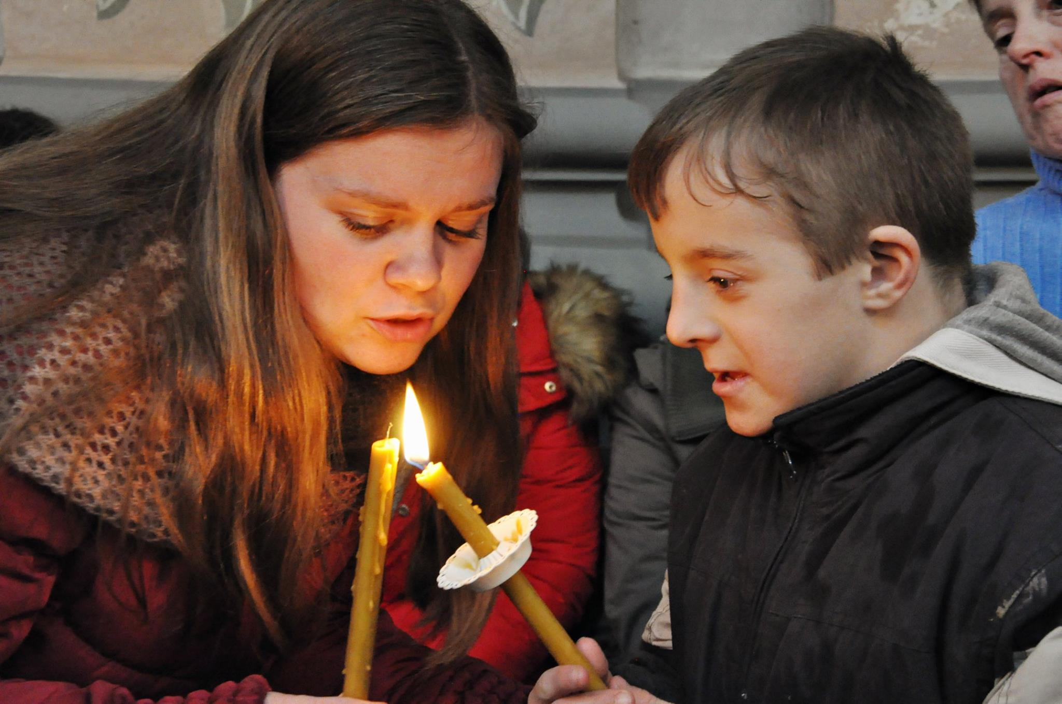
The Feast of Light

Slide 28
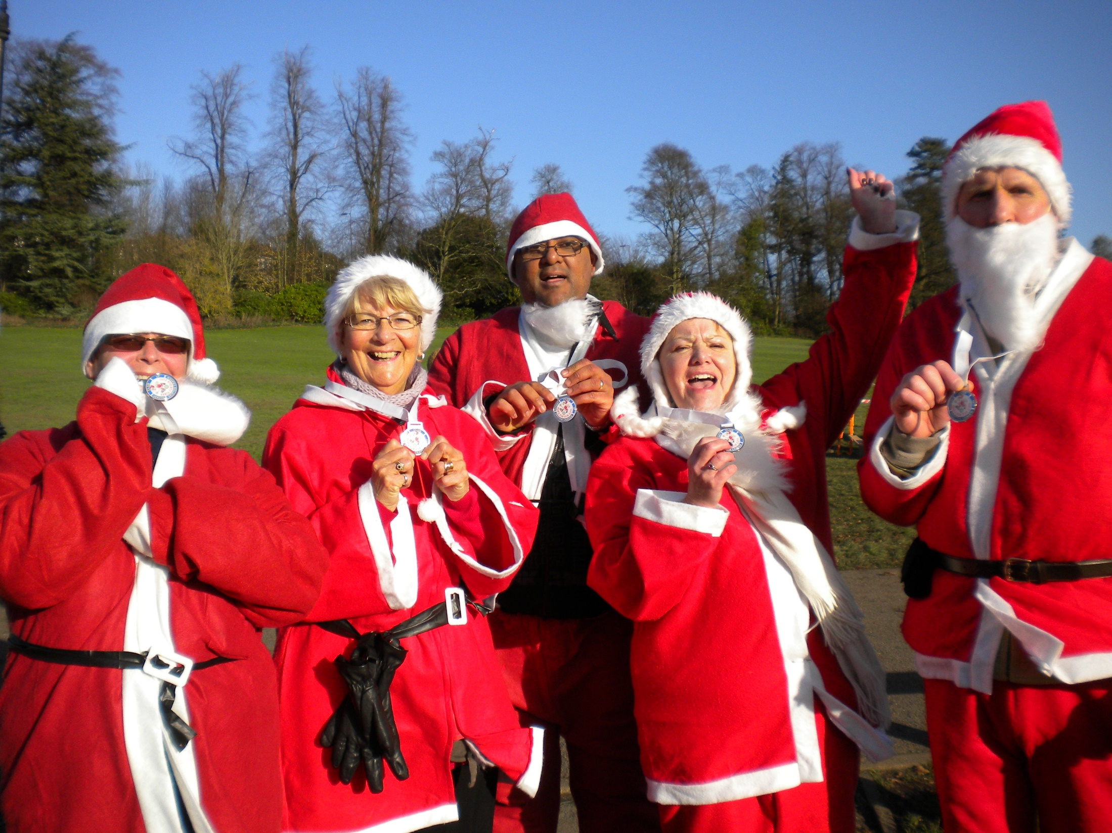
“Announcing and sharing” days

Slide 29
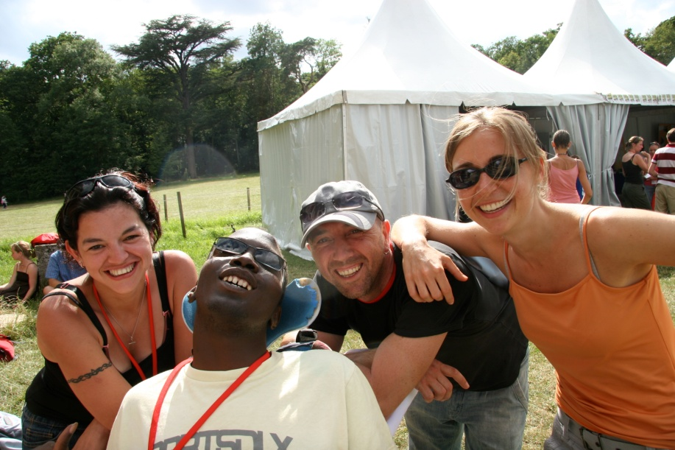
Summer camps
Notes:
The communities may have many activities other than the regular meetings. They arise according to the needs and creativity of individuals and the inspiration from God. Among these initiatives are holiday camps, retreats and pilgrimages, etc.
On the other hand, certain communities organize means of welcoming and animating activities for people with intellectual disabilities to enable their parents to have a rest. (Charter III, 2)

Slide 30
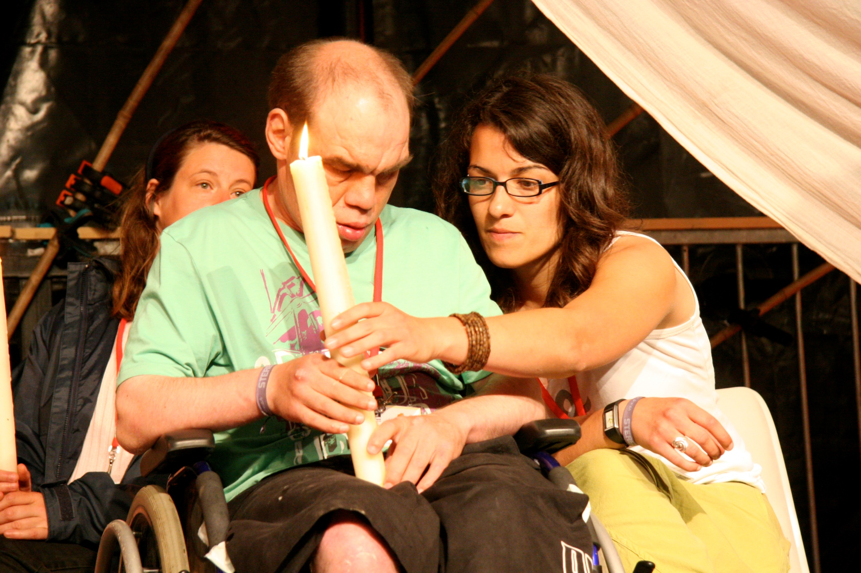
Retreats
Notes:
The communities may have many activities other than the regular meetings. They arise according to the needs and creativity of individuals and the inspiration from God. Among these initiatives are holiday camps, retreats and pilgrimages, etc.
On the other hand, certain communities organize means of welcoming and animating activities for people with intellectual disabilities to enable their parents to have a rest. (Charter III, 2)

Slide 31
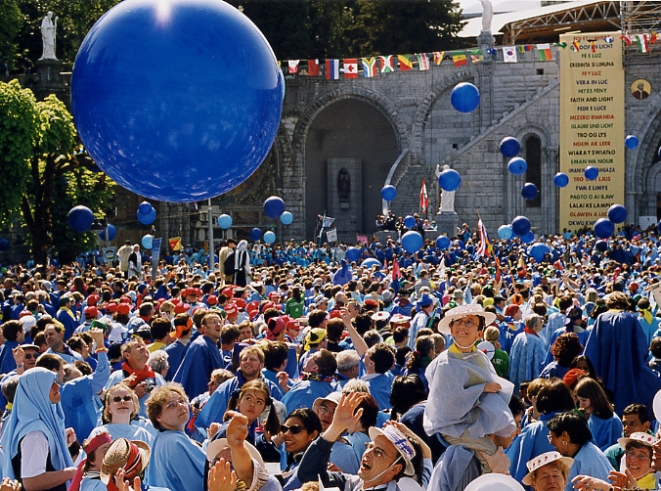
Pilgrimages
Notes:
The communities may have many activities other than the regular meetings. They arise according to the needs and creativity of individuals and the inspiration from God. Among these initiatives are holiday camps, retreats and pilgrimages, etc.
On the other hand, certain communities organize means of welcoming and animating activities for people with intellectual disabilities to enable their parents to have a rest. (Charter III, 2)

Slide 32
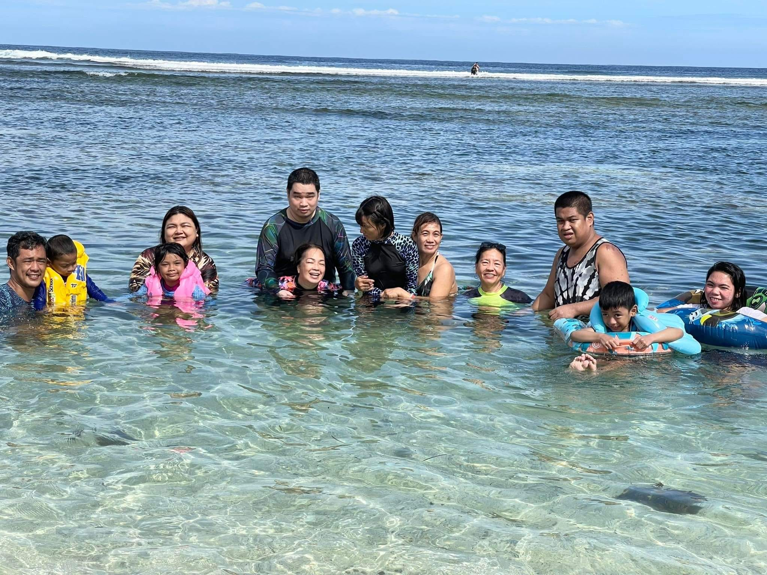
But also…
A day out on the beach,

Slide 33
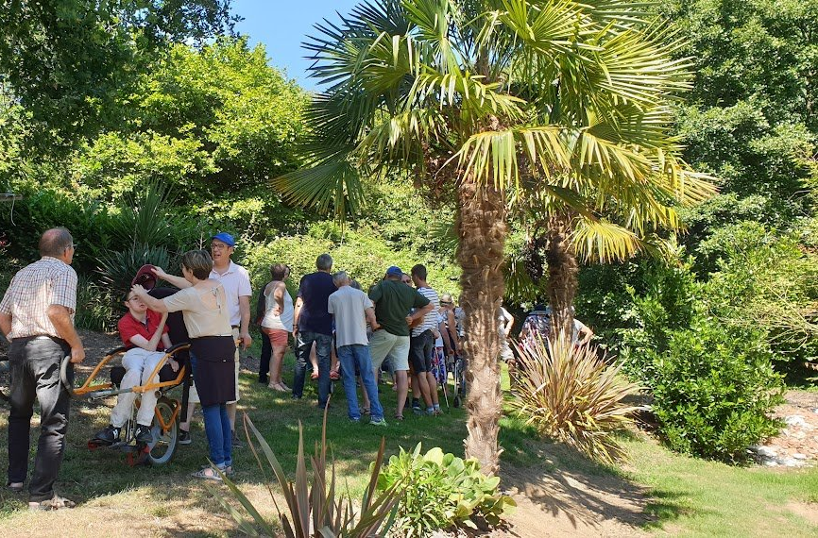
A picnic…

Slide 34
A big world-wide family

Slide 35
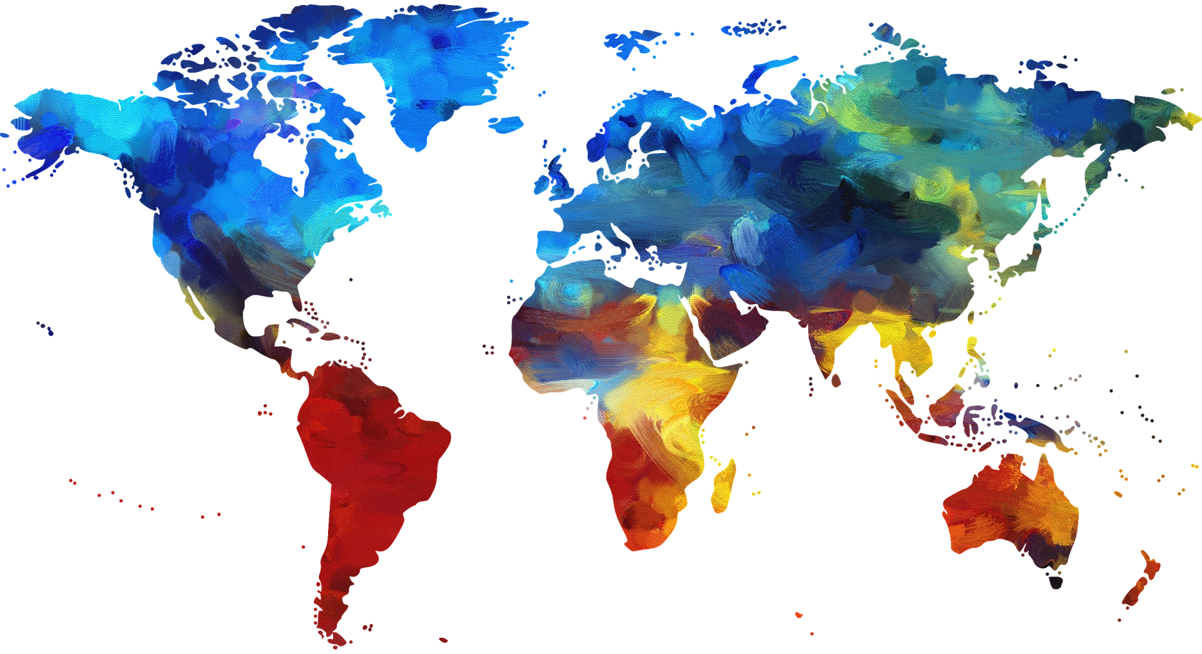
1290 communities in 86 countries
Notes:
Faith and Light communities across the world form the branches of one big international family. Within each continent, zone, country, we carry one another’s burdens, sufferings and joys. Solidarity is expressed by sharing financial support for the life of Faith and Light but also by sharing the benefits of their particular gifts, their friendship, the wisdom of their experience, and their faithfulness in prayer. As members of a single family, communities seek to live in love and unity.
(Charter, III, 4)

Slide 36
All of us are called to be Missionaries of Joy
Notes:
¡Con el tema de « Mensajeros del Gozo », Fe y Luz quiere dar testimonio al mundo de este gozo que paradójicamente se vive en las comunidades con personas que tienen una discapacidad mental! Podríamos creer que el sufrimiento es lo que más está presente en las comunidades; sin embargo, no es así: en ellas se experimenta mucho gozo y queremos dar testimonio de ello.
Mientras que muchos niños con discapacidad mental son eliminados antes e incluso después de su nacimiento, mientras que otros son abandonados, Fe y Luz cree que la vida de toda persona es única y sagrada. Incluso la menos favorecida es llamada a ser fuente de gozo y paz en las Iglesias y en el mundo. Las comunidades desean dar testimonio de la ternura de Dios para con ellos y sus familias.

Slide 37
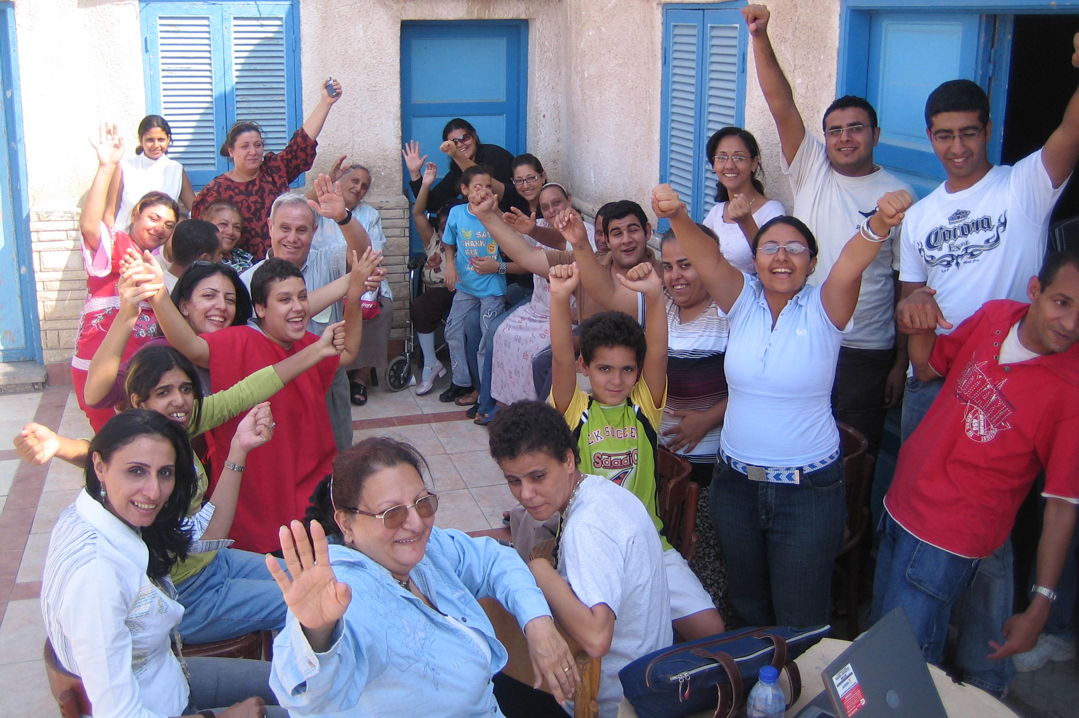
In our communities

Slide 38
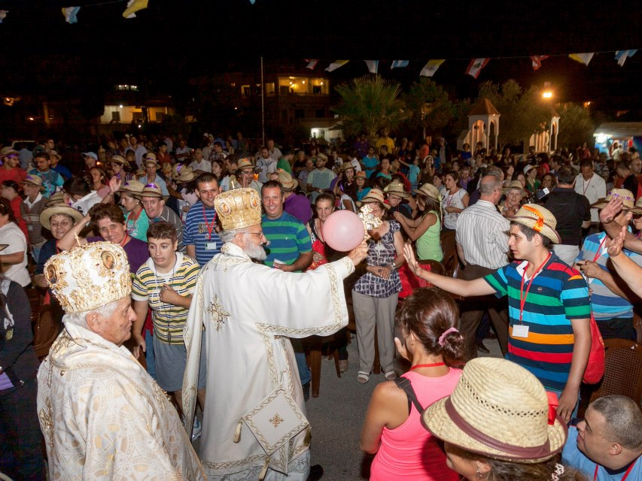
In the church and society

Slide 39
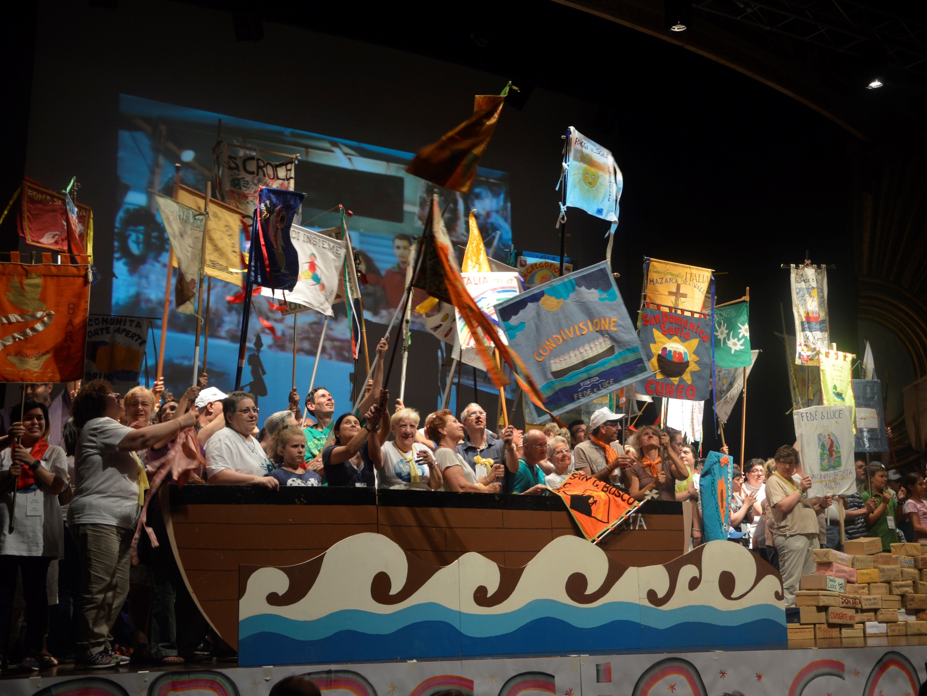
In our international family

Slide 40
Are you convinced?
If you want to discover a Faith and Light community near you,
Contact us
international@foietlumiere.org

Slide 41
3 rue du Laos 75015 París - France Tel : +33.1.53.69.44.35
international@foietlumiere.org

